Slide 1


Smart Lamp Project
Course 0
Project Overview
Ver. 01
Unrestricted
Copyright @ 2018 Innovaker

Slide 2
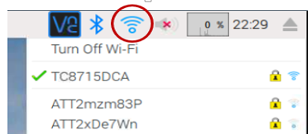
Raspberry Pi VNC Connection
Connect Raspberry Pi to monitor, keyboard and mouse
Power Pi on and enter into desktop on the Pi
Setup WiFi as picture
Get IP address of Pi by hover curse on the WiFi icon, e.g. 192.168.0.15

Slide 3
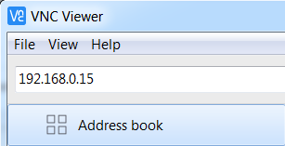
Raspberry Pi VNC Connection
Connect your laptop to WiFi in the same local network as Pi
Install RealVNC viewer on your laptop from this link
https://www.realvnc.com/en/connect/download/viewer/
Start VNC viewer from your laptop and type in the IP address of the Pi

Slide 4
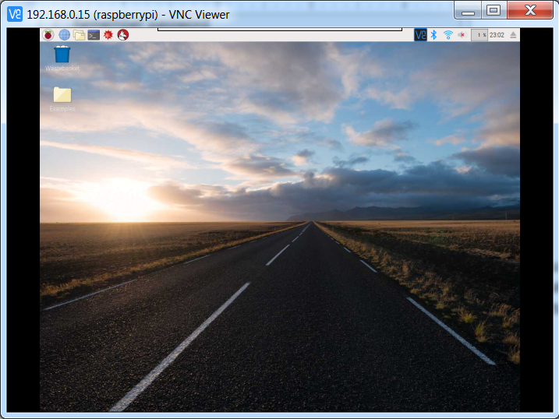
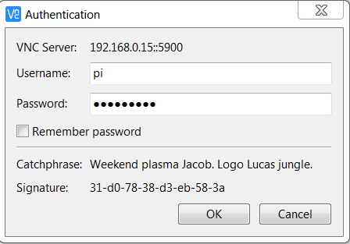
Raspberry Pi VNC Connection
4) Following window display, default user name: “pi”, password: “raspberry”, turn on “Remember password” option, the Pi desktop window will be displayed.

Slide 5
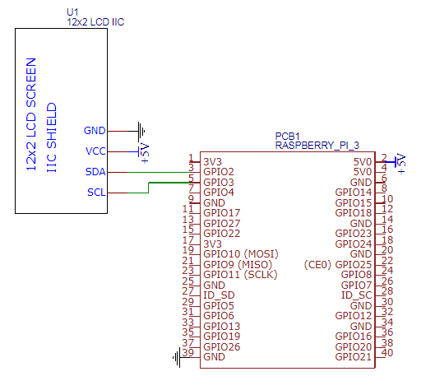
Raspberry Pi VNC Connection
Start Pi with monitor to connect wifi once
Install VNC viewer on laptop
Connect LCD as picture
Restart Pi with LCD connected
VNC to Pi by LCD displayed IP address
Note:
Use micro SD card we provided with proper setting and startup python codes to display IP

Slide 6
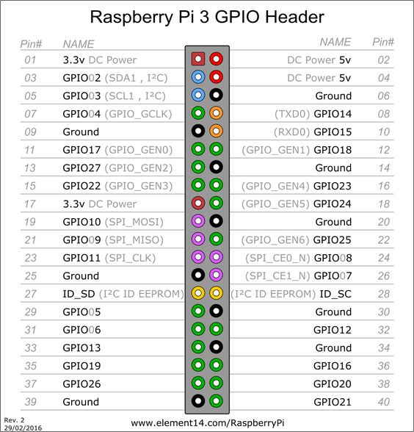
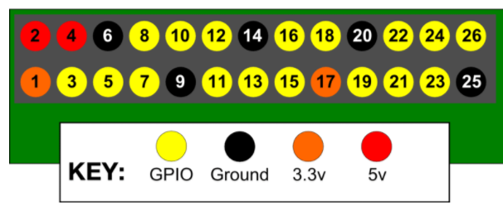
Raspberry Pi 3 GPIO
6
Copyright @ 2018 Innovaker

Slide 7
Raspberry Pi Programming
with
Sensors and Electronic Circuit
Ver. 01
Unrestricted
Copyright @ 2018 Innovaker

Slide 8
Buttons and Buzzers
Sample code see ****.py
8
Copyright @ 2018 Innovaker

Slide 9
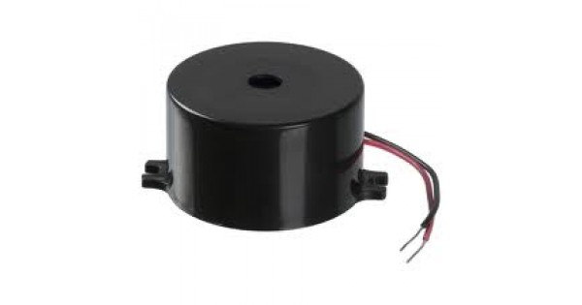
Buzzers
A buzzer or beeper is an audio signalling device,^{[1]} which may be mechanical, electromechanical, or piezoelectric (piezo for short). Typical uses of buzzers and beepers include alarm devices, timers, and confirmation of user input such as a mouse click or keystroke.
How does it work?
The buzzer consists of an outside case with two pins to attach it to power and ground.
Inside is a piezo element, which consists of a central ceramic disc surrounded by a metal (often bronze) vibration disc.
When current is applied to the buzzer it causes the ceramic disk to contract or expand. Changing the This then causes the surrounding disc to vibrate. That’s the sound that you hear. By changing the frequency of the buzzer, the speed of the vibrations changes, which changes the pitch of the resulting sound.
9
Copyright @ 2018 Innovaker

Slide 10
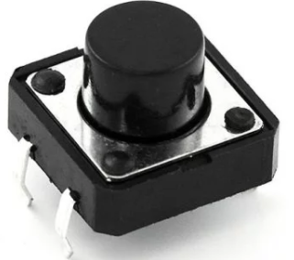
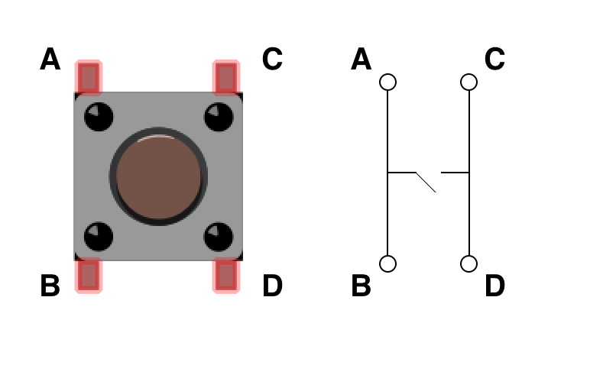
Push Button Switch
Buttons can convert physical changes into electrical signals
How does it work?
If you hold the button such that it is in a vertical orientation, then the two rails that are parallel to each other are connected internally. When the button is pressed down, the switch inside closes, connecting the two rails. Current from one branch can then flow across to the other.
10
Copyright @ 2018 Innovaker

Slide 11
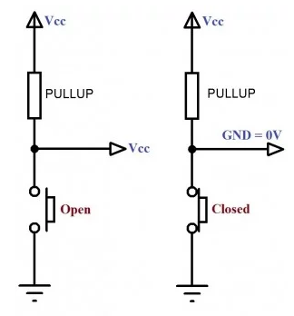
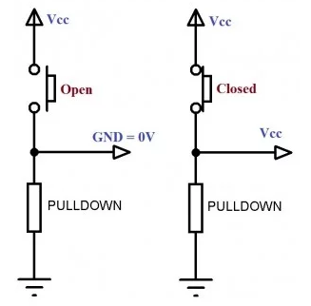
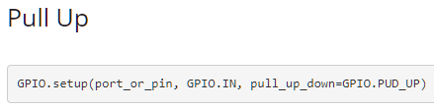
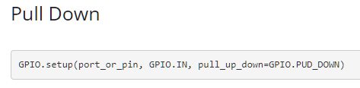
Connect a Button into Circuit
Pull-up Resistor
Pull-down Resistor
10k
10k
GPIO
GPIO
10k
10k
11
Copyright @ 2018 Innovaker

Slide 12
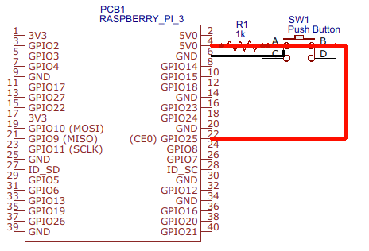
Connect a Button with Raspberry Pi
Pull-up Resistor Connection:
Terminal A – 5V power source
Terminal B – GPIO pin (GPIO 25 /Pin 22)
Terminal C – ground
Button Mode:
Un-pushed - GPIO pin detects the 5V signal as an input, and Raspberry Pi will read high as input to the GPIO.
Pushed - all 4 terminals become connected, causing the GPIO pin linked with the ground, and the Pi will read low as input to the GPIO.
12
Copyright @ 2018 Innovaker

Slide 13
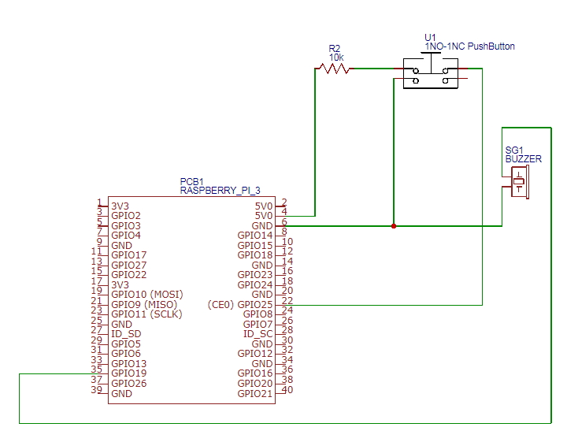
Buttons & Buzzers - Circuit and Code
Button connects to GPIO 25
Buzzer connects to GPIO 19
Python Code:
BUTTON_PIN = 25 # assign GPIO pin 25 to the button BUZZER_PIN = 19 # assign GPIO pin 19 to the buzzer
GPIO.setmode( GPIO.BCM ) # set GPIO pin # mode GPIO.setup( BUTTON_PIN, GPIO.IN, pull_up_down=GPIO.PUD_UP ) GPIO.setup( BUZZER_PIN, GPIO.OUT )
13
Copyright @ 2018 Innovaker

Slide 14
Methods for Read a GPIO Input
Two ways for read a GPIO input from a button:
Method 1 – Inquiry: continuously read the GPIO input using a loop
Method 2 – Interrupt: only reacts when GPIO input changes
14
Copyright @ 2018 Innovaker

Slide 15
Button & Buzzer - Python Code
Inquiry
import RPi.GPIO as GPIO import time
BUTTON_PIN = 11 BUZZER_PIN = 4 ON = True OFF = False | Assign pin 11 as button pin Assign pin 4 as buzzer pin
def setup(): GPIO.setmode(GPIO.BCM) GPIO.setup(BUTTON_PIN, GPIO.IN, pull_up_down=GPIO.PUD_UP) GPIO.setup(BUZZER_PIN, GPIO.OUT) | Notice how the button setup differs slightly from that of the other pins. GPIO.setup(BUTTON_PIN, GPIO.IN, pull_up_down=GPIO.PUD_UP) - the button setup takes a third parameter, a function, to determine which state the button is naturally in.
Refer file ****.py
15
Copyright @ 2018 Innovaker

Slide 16
Button / Buzzer - Python Code 2/2
def main(): while True: time.sleep(0.01) if(GPIO.input(BUTTON_PIN) == 0): print ("Button is pressed!") print ("Buzzer will be turn on!") GPIO.output(BUZZER_PIN, ON) else: GPIO.output(BUZZER_PIN, OFF) | GPIO.input(BUTTON_PIN) - Reads the status of the GPIO pin. When the pull_up_down status is GPIO.PUD_UP, the natural state is a 1 while a push is a 0
if __name__ == '__main__': try: setup() main() finally: GPIO.cleanup()
16
Copyright @ 2018 Innovaker

Slide 17
Motion Sensors
Sample code see ****.py
17
Copyright @ 2018 Innovaker

Slide 18
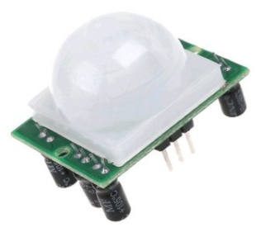
What is a Motion Sensor
A type of electronic sensor that detects for motion or movement
Used for security systems or motion sensing lights
Two types of motion sensors: active and passive
Active motion sensors: emit ultrasonic waves which are reflected back to the sensor.
Passive infrared sensors: detect infrared or heat signals emitted by humans or other animals.
The sensors included in this project is a passive infrared sensor
18
Copyright @ 2018 Innovaker

Slide 19
How Does It Work?
The passive infrared sensor has 3 pins:
power (VCC)
ground (GND)
the signal (OUT)
The infrared sensor will detect for any abrupt changes in its infrared signal, and upon detection, will send a digital output to trigger another event.
19
Copyright @ 2018 Innovaker

Slide 20
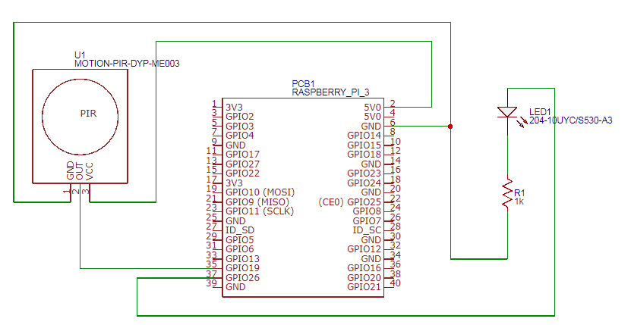
Motion Sensor - Electronic Circuit
Motion sensor connects to GPIO 19 (pin 35)
LED connects to GPIO 26 (pin 37)
Python Code:
LED_PIN = 37 MOTION_PIN = 35
GPIO.setmode(GPIO.BCM) GPIO.setup(MOTION_PIN, GPIO.IN, pull_up_down=GPIO.PUD_UP) GPIO.setup(BUZZER_PIN, GPIO.OUT)
20
Copyright @ 2018 Innovaker

Slide 21
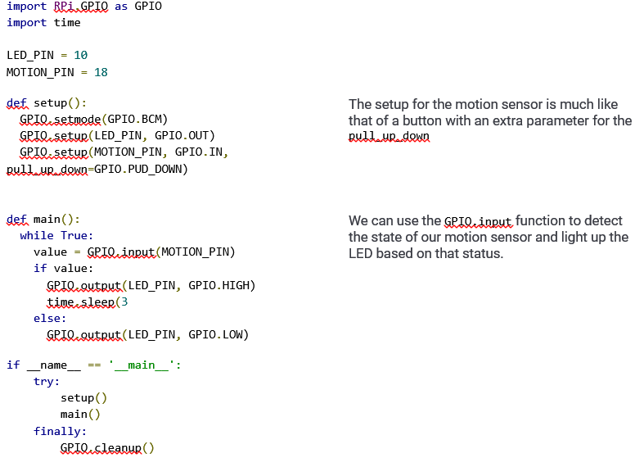
Motion Sensor - Python Code 1/2
motion1.py
21
Copyright @ 2018 Innovaker

Slide 22
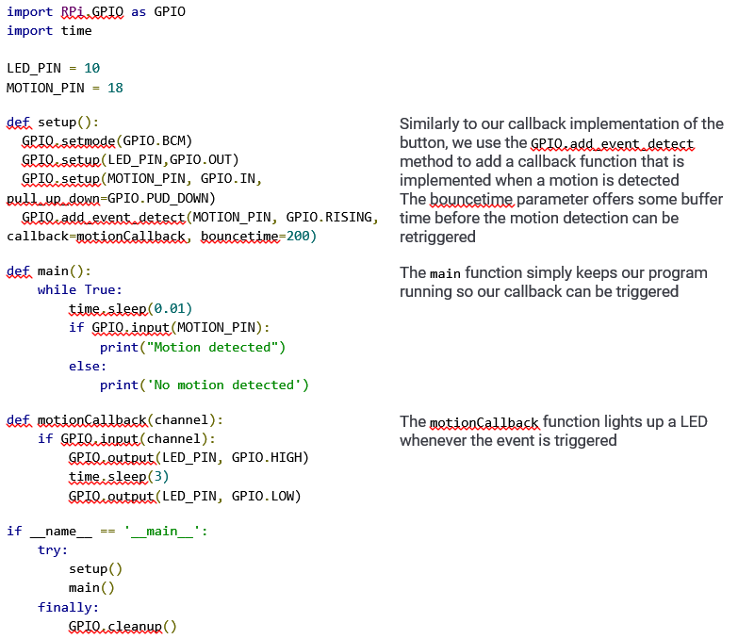
Motion Sensor - Python Code 2/2
motion2.py
22
Copyright @ 2018 Innovaker

